Slide 1

In Vehicle Pressure Data System (FDS1)
Melvin Byrd
Regional Sales Manager, AR Group, MEAS

Slide 2
In Vehicle Pressure Data System
What is this Product?
Portable, Rugged ESP Scanner Interface
  Based off existing DTC Initium circuitry
  Optimized for “in flight” test operation
  INITIUM - Repackaged to look the part
Why was it created?
  Fills the gap in DACUs left by discontinued S8256
  Offers users another option for pressure scanner interfaces considering the lack of progress by the “Big Three”
  *Requires inventory conversion from Temp Sense to DTC
2

Slide 3
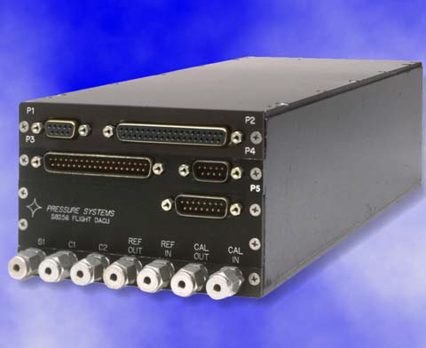
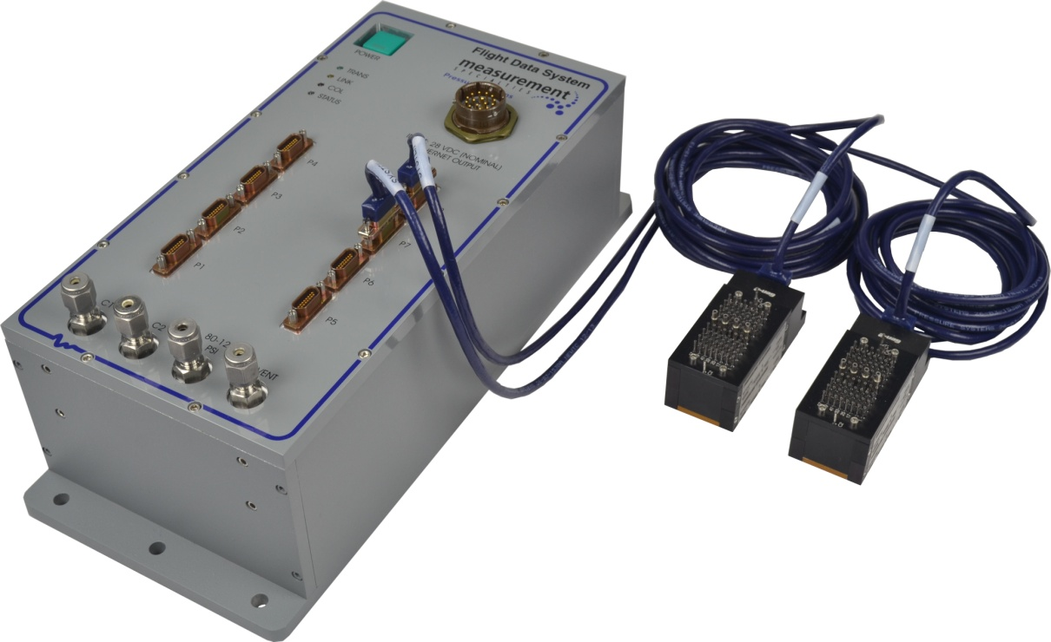
In Vehicle Pressure Data System
S8256 - Discontinued
Military Aircraft
Commercial/Private Aircraft
Long Haul Truck
496 Channel Max
Conventional Scanners with personality EPROM (Temp Sense)
FDS1
All of the above
512 Channel Max
HD DTC Scanners / Direct Connection
© Copyright 2014, Measurement Specialties, Inc.

Slide 4
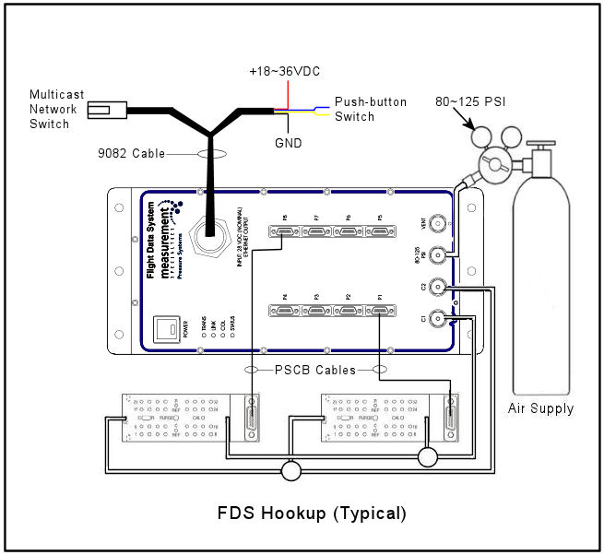
In Vehicle Pressure Data System
4

Slide 5
In Vehicle Pressure Data System
Industries Serviced by this Product?
Passenger Vehicle Manufacturers
  Regional Jet Manufacturers
  Corporate / Private Aircraft Manufacturers
  Buses / Trains / Trucks
Engine Manufacturers
  New Engine Certification
  Performance Enhancement Verification
5

Slide 6
In Vehicle Pressure Data System
FDS1
Created in 2014
  Pre-Engineered System for up to 512 Pressure Channels
  “Live @ Power up” Data Acquisition
  Guaranteed System Accuracy - Digital Temperature Compensation
  On-Line Rezeroing upon Customer supplied switch closure
  Engineering Unit output via UDP or TCP/IP
Flight Tests
Portable Test Stand
Low speed Wind Tunnel Tests
Fuel economy studies for Long Haul Trucks
6

Slide 7
In Vehicle Pressure Data System
New Development
  Hardened Aluminum Enclosure
  UDP & IGMP Multicast Data Streaming
  “Live @ Power Up” Data Acquisition
  Initialization / Configurations stored in non-volatile memory
Existing compatibility
  Proven Digital Temperature Compensated Accuracy
  Integrated Pneumatic Control Solenoids for C1/C2
  ESP “HD” Scanners with DTC (Gen 1 & Gen 2)
7

Slide 8
In Vehicle Pressure Data System
Data Streaming Terminology (As defined by Microsoft)
User Datagram Protocol (UDP) is a TCP/IP standard used by some programs instead of TCP for fast, lightweight, transportation of data between multiple TCP/IP hosts simultaneously.
Internet Group Management Protocol (IGMP) is used between hosts and their local multicast router. IGMP messages are encapsulated by IP and use the IP protocol number 0x02
8

Slide 9
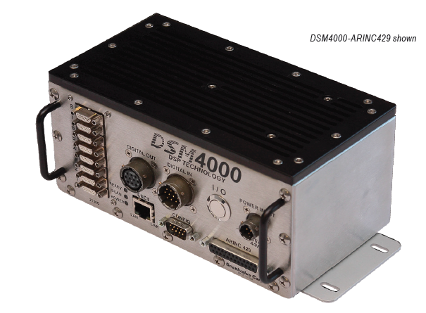
In Vehicle Pressure Data System
Competition:
Scanivalve – DSM4000
(Digital Service Module)
Specifications
0-60°C Operation
9-36VDC Power Requirement
15 Hz/CH TCP/IP ASCII Data
625 Hz/CH UDP Binary
9

Slide 10
In Vehicle Pressure Data System
Competition:
Scanivalve – DSM4000
(Digital Service Module)
Features
DSP Technology
Sample rates up to 625 Hz/CH
Up to 8 ZOC Scanners (512 CH)
Ethernet 100BaseT output
Optional ARINC429
Digital Input & Output capability
DSP Technology:
“Scanivalve uses a DSP processor
For fast EU conversion and Throughput.”
Based on RAD technology:
“There is an A/D for each ZOC module,
Plus internal memory for DSC and ZOC
Module information storage”
10

Slide 11
In Vehicle Pressure Data System
Target Customers:
Small to Mid size Aircraft builders or developing state funded aircraft builders without strong ties or who are under served by the “Big Three” Telemetry Companies:
Teletronics Technology Corporation (TTC)
L-3 Communications Corp –Telemetry West
Curtiss-Wright (aka) Acra Control
Aero Engine Manufacturers who wish to benefit from DTC Scanner accuracy during in-flight tests
Industry funded University Research Programs
11

Slide 12
In Vehicle Pressure Data System
Future Development – FDS2
  IEEE-1588 2008 (PTPv2)
  Heater Element Option for extended temperature operation
  Software controlled Trigger mode selection
12

